Slide 1
SUBSELECTS IN SQL
James Larkin – Data Analytics Instructor

Slide 2
AGGREGATING DATA WITH SQL
LIGHTNING ROUND REVIEW
What is a NULL? How is it different from a blank?
Name ways that you can modify a NULL.
How are CASE statements used? Can they be useful with NULLs?
Which operation will return an error condition when it encounters a NULL field?

Slide 3
SUBSELECTS IN SQL
LEARNING OBJECTIVES
Ask two or more questions in a single SQL query.
Nest queries within different parts of SELECT statements.
Perform multi-step aggregations or filtering within one query.

Slide 4
SUBSELECTS IN SQL
INTRODUCTION: SUBSELECT

Slide 5
SUBSELECTS = SUBQUERIES = NESTED QUERY
Until now, queries had no effect on each other….but what if we wanted to use the results from one query to inform another? Subselects, also called subqueries, allow us to do just that.
We can use subqueries to create nested queries that:
Run one query,
Get a result, and
Then feed that result immediately into another query.
Subqueries may be used within WHERE, FROM, or SELECT statements.
Notes:
Instructor notes: As vocabulary is a key factor in every area of technology, point out to students the use of language for understanding the idea of combining multiple questions into one query.
SUBSELECT = SUBQUERY = NESTED QUERIES.

Slide 6
SUBSELECTS = SUBQUERIES
Subqueries also let us change the level of aggregation on the data and perform analysis on a larger scale.
For example, sales in the Adventure Works sales database are on a transactional basis, but we can reaggregate this to a monthly or weekly basis to look at trends at different levels.
Notes:
Instructor notes: As vocabulary is a key factor in every area of technology, point out to students the use of language for understanding the idea of combining multiple questions into one query.
Meaning: SUBSELECT = SUBQUERY = NESTED QUERIES.

Slide 7
SUBSELECTS IN SQL
DEMO: SUBSELECT SYNTAX

Slide 8
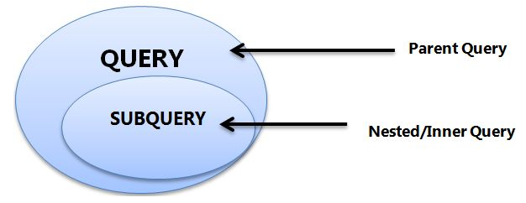
SUBSELECTS: BASIC CONSTRUCTION GUIDELINES
Subqueries are enclosed in parentheses.
Subquery structures need complete query components for execution: they must have SELECT, FROM, and a specified criteria.
Inner queries run first (inside -> out)
Assigning aliases is important for syntax and readability.
Source: graphic https://goo.gl/MsfKjc

Slide 9
SUBSELECTS: ASKING MULTIPLE QUESTIONS
Let’s say you have two locations and you want to know, on average, how often each store is making more than $150,000.
In other words, you need to get the count for when recorded sales are more than $150,000 for each location and then create an average for that performance record.
In the subquery:
We need to identify the store with average sales of more than $150,000.
We need to compute the average sales for each store.
Notes:
(as illustrated in table on the next slide)

Slide 10
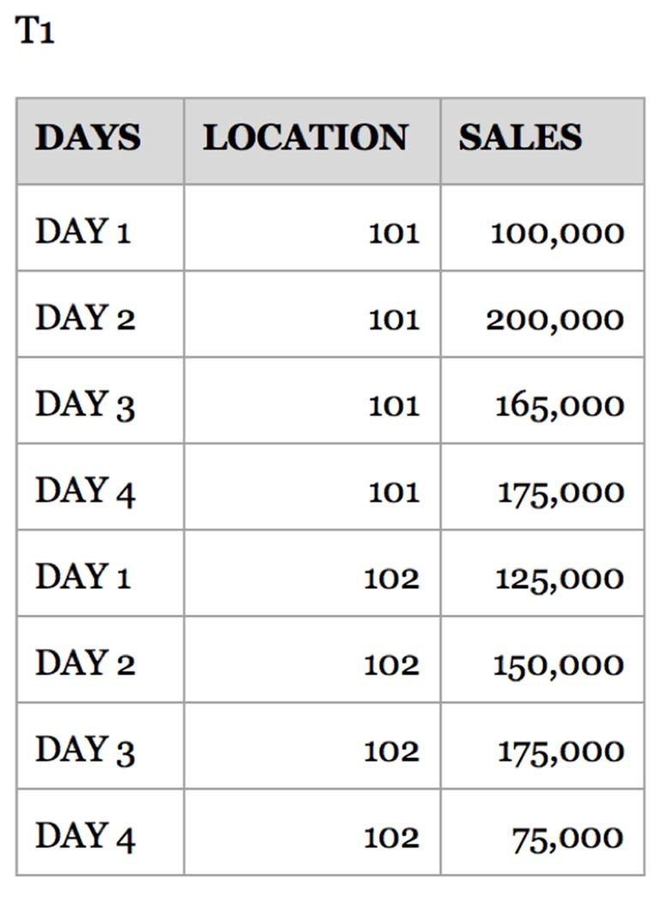
SUBSELECTS: SAMPLE TABLE
Let’s use this sample data table to create a subquery.
The table is named “T1” (as an alias for: “Table 1”) and contains the total sales by location for each day.
T1

Slide 11
SUBSELECT SYNTAX WALK THROUGH
Review the subquery first:
SELECT location, AVG(Top_Stores) FROM (
SELECT location,
COUNT(*) as Top_Stores FROM table_1
WHERE sales >150000
GROUP BY location) as T1
GROUP BY T1.Location;
Select all of the locations.
Do a COUNT of those locations and rename the result Top_Stores.
Filter the results for only stores with more than $150,000 in sales per day.
Because there is an aggregation (COUNT), there has to be a group based on what is being aggregated (location).
T1 is an alias for the results. T1 serves as a temporary table, holding the results of this SELECT statement.
You can rename the alias whatever you’d like.

Slide 12
SUBSELECT SYNTAX WALK THROUGH
Next, review the SELECT statement that will be reading results from T1:
This selects locations and an average for Top_Stores, which was created in your inner query using the COUNT function.
The FROM tells us where the information is coming from: the subquery.
Because there is an aggregation (AVG), the locations need to be grouped.
Notice in the GROUP BY that you have to reference the alias T1.
SELECT location, AVG(Top_Stores) FROM (
SELECT location, COUNT(*) as Top_Stores FROM table_1
WHERE sales >150000
GROUP BY location) as T1
GROUP BY T1.Location;

Slide 13
SUBSELECTS: QUERY TYPES
A subquery is a query within a query that allows for multi-step operations.
Subqueries are a common requirement when dealing with layered aggregations, filtering, and creating temporary tables with calculated or categorized columns.
There are two types of subqueries we’ll be exploring today:
Type 1 allows us to feed the results of one query as additional data for the outer query.
Type 2 allows us to create a filter to test data against using the IN operator.

Slide 14
SUBSELECT SYNTAX: USING RESULTS
First, we will use the results of one query as a data source for the outer query by placing the subquery in the FROM clause. The syntax generally looks like this:
SELECT something FROM (SELECT something else FROM somewhere) AS temp;
We supply an entire query between parentheses where we’d normally have a table. The outer query then treats the results of the inner query as if they were another table.
Each independent SELECT query can be as complex as is needed. Give an alias name to the inner query with the AS keyword, even if you never refer to the inner query by this alias.

Slide 15
SUBSELECT SYNTAX: USING RESULTS
Let’s find the average weights of the three types of bicycles in the Adventure Works product portfolio; Touring, Road, and Mountain.
First, let’s use a CASE statement to categorize the types of bicycles:
SELECT p.name,
CASE
WHEN p.name ILIKE '%Mountain%' THEN 'mountain'
WHEN p.name ILIKE '%Road%' THEN 'road'
WHEN p.name ILIKE '%Touring%' THEN 'touring'
ELSE 'unknown'
END AS type, p.weight
FROM production.product p WHERE p.productnumber ILIKE 'BK%';

Slide 16
SUBSELECT SYNTAX: USING RESULTS
Then, we use a GROUP BY statement to aggregate (AVG) our weights:
SELECT subq.bike_type, ROUND(AVG(subq.weight),2) AS avgweight
FROM(
SELECT p.name,
CASE
WHEN p.name ILIKE '%Mountain%' THEN 'mountain'
WHEN p.name ILIKE '%Road%' THEN 'road'
WHEN p.name ILIKE '%Touring%' THEN 'touring'
ELSE 'unknown'
END AS bike_type,
p.weight
FROM production.product AS p
WHERE p.productnumber ILIKE 'BK%'
) AS subq
GROUP BY subq.bike_type
ORDER BY avgweight ASC;
Notes:
NOTE: subqueries MUST be aliased (‘as subq’ above)

Slide 17
SUBSELECT SYNTAX: CREATING FILTER
The second type of subquery allows you to filter the results of one query by the results of another using the IN operator. This type of query looks like:
SELECT *
FROM table_one
WHERE col_one IN (SELECT other_val FROM some_other_table);
Here, we will be able to filter table_one where the values of col_one exist in the results of our inner subquery.
In this use case, we do not need an alias on the subquery. We also can only call one column in the subquery.

Slide 18
SUBSELECT SYNTAX WALK THROUGH: CREATING FILTER
Let’s look at an example:
How many of each type of bicycle has been sold in the history of Adventure Works?
Write the query that selects completed bicycles (ready to ride, fully assembled).
SELECT county FROM counties WHERE population < 100000;

Slide 19
SUBSELECT SYNTAX WALK THROUGH: CREATING FILTER
Let’s look at an example:
How many of each type of bicycle has been sold in the history of Adventure Works?
Write the query that selects completed bicycles (ready to ride, fully assembled).
SELECT p.productid
FROM production.product AS p
WHERE p.productnumber ILIKE 'BK%';

Slide 20
SUBSELECT SYNTAX WALK THROUGH: CREATING FILTER
Then, insert it into the outer query’s WHERE clause:
SELECT p.name, od.productid, SUM(od.orderqty) as qtyordered
FROM sales.salesorderdetail AS od
LEFT JOIN production.product AS p
ON p.productid = od.productid
WHERE od.productid IN (
SELECT p.productid
FROM production.product AS p
WHERE p.productnumber ILIKE 'BK%')
GROUP BY p.name, od.productid
ORDER BY qtyordered DESC;
Here, the inner query must only return one column for an IN filter. Consider that the inner query is building an array of values that are then substituted into the WHERE clause in the outer loop.

Slide 21
SUBSELECT SYNTAX: CREATING FILTER
Another advantage of this methodology is that the NOT IN function allows you to use a subquery to exclude data as well.
Going back to the previous query, we can find the number of products sold that were not finished / assembled bicycles.

Slide 22
SUBSELECT SYNTAX: CREATING FILTER
SELECT p.name, od.productid, SUM(od.orderqty) as qtyordered
FROM sales.salesorderdetail AS od
LEFT JOIN production.product AS p
ON p.productid = od.productid
WHERE od.productid NOT IN (
SELECT p.productid
FROM production.product AS p
WHERE p.productnumber ILIKE 'BK%')
GROUP BY p.name, od.productid
ORDER BY qtyordered DESC;

Slide 23
SUBSELECTS IN SQL
GUIDED PRACTICE: SUBSELECTS

Slide 24
SUBSELECTS: MORE GUIDELINES
Be careful with the logic you design into your query with a GROUP BY clause. Be sure to match the location of the aggregation being performed.
CASE statements can be used in both types of subqueries: the inner query and the outer query.
One useful and common construction is to use the inner query to create a flag (a binary value) and then use the outer query to average that value.
Let’s build an example using a CASE classification and a binary flag.

Slide 25
SUBSELECT WITH CASE
Earlier, we classified products by price. Now, let’s say we want to use those categories to count how many products fit into each group.
Let’s look at our original classification query:
SELECT p.listprice,
CASE
WHEN p.listprice <= 0 THEN 'free'
WHEN p.listprice <= 50 THEN 'cheap'
WHEN p.listprice <= 300 THEN 'affordable'
WHEN p.listprice > 300 THEN 'expensive'
END AS affordability
FROM production.product AS p;
Notes:
Case, When, then, end as

Slide 26
SUBSELECT WITH CASE
This will serve as our inner query, with the outer query counting occurrences:
SELECT subq.affordability, COUNT(subq.listprice) AS numberofproducts
FROM
(SELECT p.listprice,
CASE
WHEN p.listprice <= 0 THEN 'free'
WHEN p.listprice <= 50 THEN 'cheap'
WHEN p.listprice <= 300 THEN 'affordable'
WHEN p.listprice > 300 THEN 'expensive'
END AS affordability
FROM production.product AS p
) AS subq
GROUP BY subq.affordability
ORDER BY numberofproducts DESC;
Notes:
Output:
'large','1'
'medium','5'
'small','93’
Query:
SELECT county_size, COUNT(*) AS number_counties
FROM
(
SELECT county, population, CASE
WHEN population >= 400000 THEN 'large'
WHEN population >= 100000 THEN 'medium'
ELSE 'small'
END AS county_size
FROM counties
) AS temp
GROUP BY county_size;

Slide 27
SUBSELECT USING A BINARY FLAG
Let’s say you wanted to know what percentage of listprice’s were $0.
First, create the inner query that classifies each listprice as either $0 or not:
SELECT p.listprice,
CASE
WHEN p.listprice = 0 THEN 1
ELSE 0
END AS isfree
FROM production.product AS p;
Notes:
(we’ll use “1” and “0” as our binary classifiers) SELECT p.listprice,
CASE
WHEN p.listprice = 0 THEN 1
ELSE 0
END AS "isfree"
FROM production.product p

Slide 28
SUBSELECT USING A BINARY FLAG
Now, wrap that query in an outer query that averages the flag per store:
SELECT ROUND(AVG(subq.isfree)*100, 1) AS isfreepercentage
FROM
(SELECT p.listprice,
CASE
WHEN p.listprice = 0 THEN 1
ELSE 0
END AS isfree
FROM production.product AS p) AS subq
Notes:
39.7% free items (a list price of $0)

Slide 29
SUBSELECTS IN SQL
INDEPENDENT PRACTICE-HOMEWORK: SUBSELECTS

Slide 30
ACTIVITY: SUBSELECTS
DIRECTIONS
Adventure Works is getting a lot of press from the boost in sales recently, and now the PR office has to respond to a couple of press inquiries about the sales people in the field because they’ve taken so much market share recently.
Please use subqueries and CASE statements when possible.
How many sales people are currently have active territories? (Use sales.salesperson)
How many sales orders have been processed by these sales people? (Use sales.salesorderheader)
Create tiers for sales bonus amounts for all sales persons with territories assigned:
$0 -> $2,000: tier 1
$2,001 - $4,500: tier 2
$4,500+ : tier 3
Create a table showing the total sales generated in each of the bonus tiers. What trends do we see?
Are there any errors we may be making by using this tiering strategy?
Notes:
.

Slide 31
SQL DATA AGGREGATION
RESOURCES
“Using Subqueries in the Select Statement” by essentialSQL.com: https://goo.gl/GsfwAb
“Writing Subqueries in SQL” by Mode Analytics: https://community.modeanalytics.com/sql/tutorial/sql-subqueries/
Beginner SQL Tutorial: http://beginner-sql-tutorial.com/sql-subquery.htm

Slide 32
SQL DATA AGGREGATION
CITATIONS
Subquery graphic illustration from c-sharpcorner.com: https://goo.gl/MsfKjc.

